Slide 1

Building Robust CI/CD Pipelines with
GitHub Apps and Custom Automation
Emanuel Palm

Slide 2

🔁
MirrorRepo-Core
MirrorRepo-Internal

Slide 3
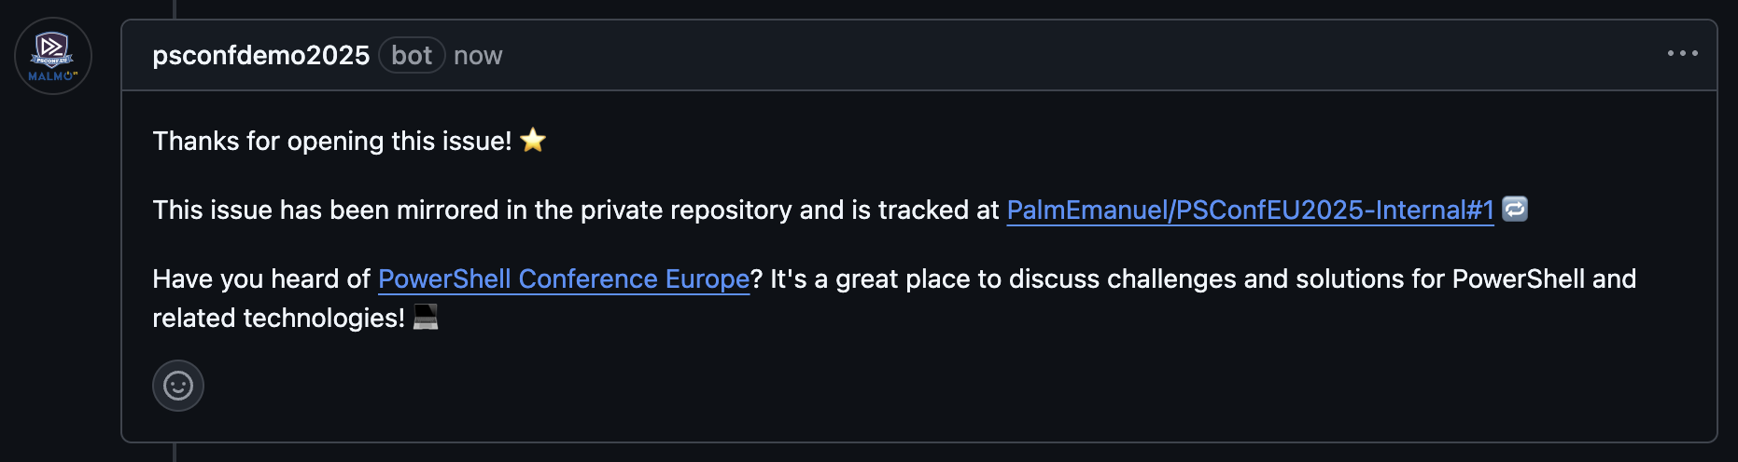

+1
MirrorRepo-Core
MirrorRepo-Internal

Slide 4
+1
+1
MirrorRepo-Core
MirrorRepo-Internal

Slide 5

+1
+1
MirrorRepo-Core
MirrorRepo-Internal

Slide 6
Mirror Issue to Internal Repo
+1
+1
MirrorRepo-Core
MirrorRepo-Internal
Post Comment on Original Issue

Slide 7






Emanuel Palm
💙 Everything-as-Code
📦 Makes modules & tools
📃 Fan of Open Source
☁️ Blogs at pipe.how
☕️ Roasts coffee at arkanum.coffee
Fun facts!
🪨 Climbing
🏃 Running
🥏 Disc Golf
🇸🇪
Cloud Specialist, Microsoft MVP
@PalmEmanuel

Slide 8
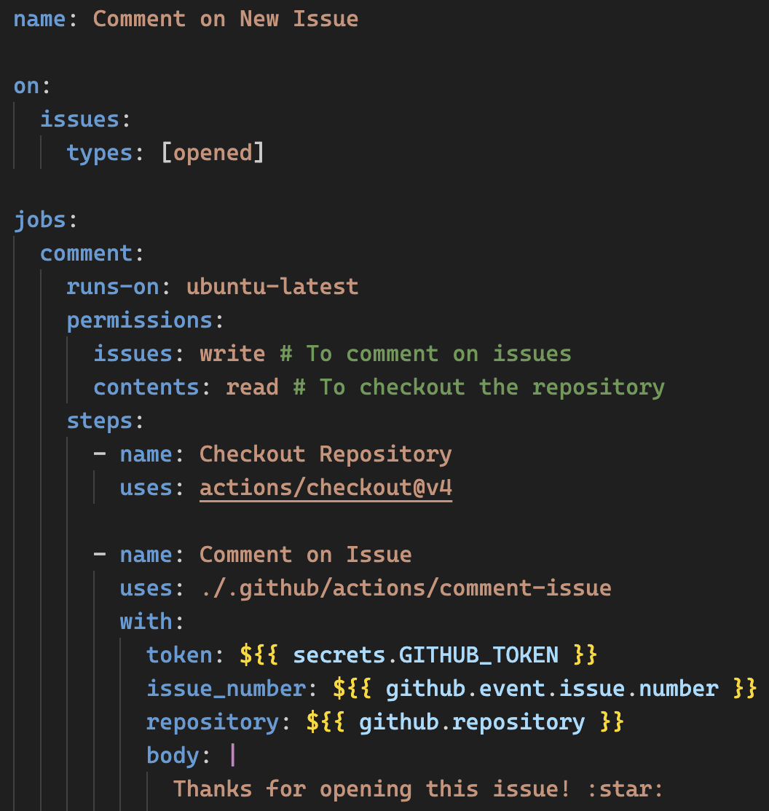
Example of a GitHub Workflow

Slide 12
DEMO
Notes:
5 min

Slide 13


Key Takeaways
📸
GitHub Apps allow us to extend GitHub
Cross-repository permissions
We explored issue creation & comments
But any event is possible with webhooks
Opens the door to any automation
Improve organization & developer productivity
github.com/PalmEmanuel/NordicIntegrationSummit2025 github.com/PalmEmanuel/MirrorRepo-Core
github.com/PalmEmanuel/MirrorRepo-Internal
@PalmEmanuel

Slide 14


Thank you!
Please scan the QR code to rate this session. It’s anonymous, takes 30 seconds,
and helps us grow together.
@PalmEmanuel

